Slide 1


CHINOOK
MUSIC STORE
Data Analysis and Strategic Recommendations
Tarannum Vaid | 29-06-2024
Chinook
Music Store

Slide 2

CONTENT
01
02
03
04
Introduction
Objectives
Data Overview
Methodological Approach
05
06
07
08
Analyses
Marketing Strategy
Customer Retention
Geographic Expansion

Slide 3
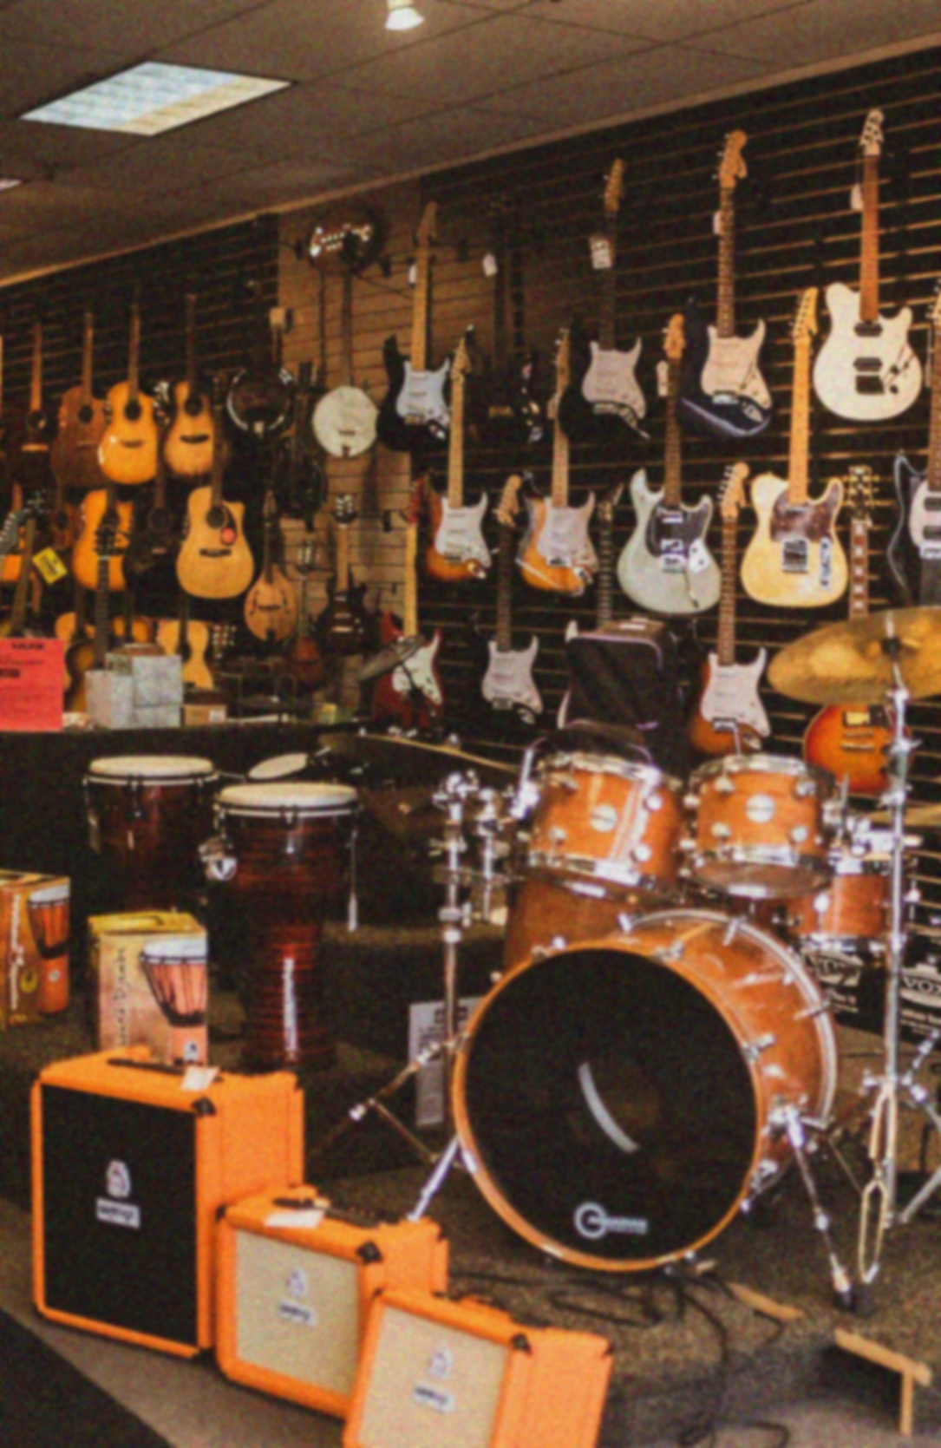



INTRODUCTION
Welcome to our exploration of Chinook Music Store, a cornerstone of musical enrichment in North Central Washington since 1995.
Chinook Music Store’s story begins with a simple mission: to bring the joy of music to everyone, from budding school musicians to seasoned rock bands. Over the years, Chinook has become synonymous with quality and passion, fostering a community of music enthusiasts. But as the landscape of the music industry changes, so do the needs and expectations of the customers.
To stay ahead, Chinook must delve deeper into the heart of its operations, uncovering insights that will guide the strategic decisions. This presentation will take you on a journey through the data analysis project, unveiling the hidden patterns and trends that shape the music store’s business.
Let’s unlock the secrets within the given data, using them to fuel Chinook’s growth and strengthen its position in the industry.
Chinook
Music Store

Slide 4

PROBLEM STATEMENT
Embracing Change in the Music Industry
The music industry is as dynamic as the melodies it produces.
For Chinook Music Store, the challenge lies in adapting to these shifts while maintaining the core values.
To remain a leader in the market, it is needed to
Adapt to the dynamic music industry while maintaining core values.
Understand customer purchasing habits and regional variations to optimize promotional strategies.
Explore untapped market segments through detailed analysis of sales trends and customer demographics.
Tailor offerings to meet the unique needs of each community.
Enhance market presence and deepen connections with music lovers through data-driven innovation.

Slide 5






OBJECTIVES
Objective nº 1
Objective nº 2
Objective nº 3
Objective nº 4
A thorough analysis of sales trends, gaining a deeper understanding of customer demographics, and identifying potential market opportunities.
Examining seasonal variations, product popularity, and regional differences to refine Chinook’s sales approach.
Identifying market opportunities to enable the company to explore new segments and expand its reach.
Understanding customer demographics to meet diverse marketing needs.

Slide 6
DATA OVER
VIEW
Mapping Chinook’s Musical Database
Customer & Sales Data:
Customer: Profiles with names and contacts.
Invoice & InvoiceLine: Tracks sales, items, and quantities.
Music Catalog:
Track: Includes name, album, genre, and price.
Album & Artist: Organizes titles and artist info.
Genre: Categorizes music by type.
Staff & Media:
Employee: Details roles and contacts.
Playlist & MediaType: Organizes playlists and formats.

Slide 7
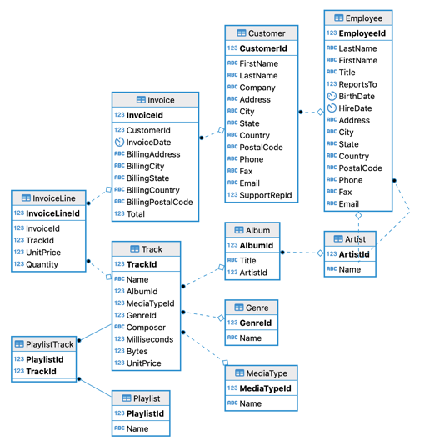
Chinook
Music Store

Slide 8

METHODOLOGICAL APPROACH
Navigating the Data Seas
Data Exploration with SQL: Utilized SQL queries to extract relevant data from various tables, focusing on customer transactions and sales history.
Aggregation Techniques: Implemented GROUP BY and other aggregation functions to summarize key metrics, such as total sales by genre and average purchase value.
Pattern Recognition: Analyzed customer purchasing patterns to identify trends, like peak purchasing times and popular products.
Statistical Analysis: Calculated customer lifetime value and retention rates to understand long-term profitability and loyalty. Analyzed purchase frequency to segment customers into different engagement levels.
Strategic Insights: Insights guided the creation of targeted marketing strategies, optimizing promotions based on customer behavior and preferences.

Slide 9
Analysis of Questions

Slide 10
OBJECTIVE
QUESTIONS
Chinook
Music Store

Slide 11
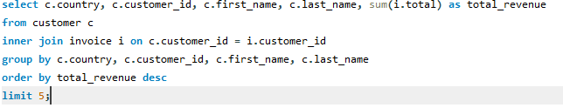
Country-wise top 5 customers by total revenue
Query Explanation:
It combines data from the customer and invoice tables, aggregating total revenue for each customer. The results are grouped by country, customer_id, first_name, and last_name, then ordered in descending order by total_revenue. The LIMIT 5 clause restricts the output to the top 5 highest revenue-generating customers.
Insights:
František Wichterlová leads in the Czech Republic with 144.54 units, followed closely by Helena Holý at 128.70 units.
Luís Gonçalves stands last at top 5 with 108.90 units from Brazil.

Slide 12
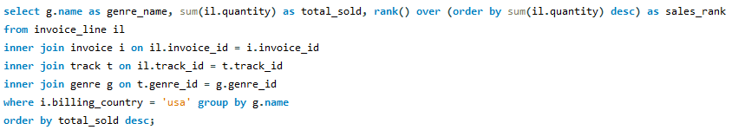
Genres ranked based on their sales performance in the USA
Query Explanation:
This query joins invoice_line, invoice, track, and genre tables to aggregate sales data by genre. The RANK() window function assigns a rank to each genre based on descending total sales (total_sold). Results are grouped by genre_name and ordered by total_sold in descending order to show which genres are the top sellers in the USA.
Insights:
Rock leads in sales with 110 units, indicating strong popularity among USA customers. Metal and Hip Hop/Rap tie for second place with 19 units each, showing similar sales volumes in these genres.
Blues, Classical, Latin, and Jazz each have minimal sales (2, 1, 1, and 1 units respectively), suggesting niche markets within the USA.

Slide 13
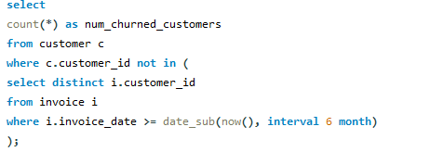
Customer Churn Rate Analysis
Assumption: Calculations based on the assumption that customers who stopped purchasing for 6 months are considered churned.
Subquery: Used a subquery to identify distinct customer IDs from invoices within the last six months.
Exclusion: Applied a `NOT IN` clause to exclude these active customers from the customer table.
Count: Counted the customers not included in the active list.
Insights: Identified 59 churned customers, providing a clear measure of customer erosion over the defined period.

Slide 14
SUBJECTIVE
QUESTIONS
Chinook
Music Store

Slide 15
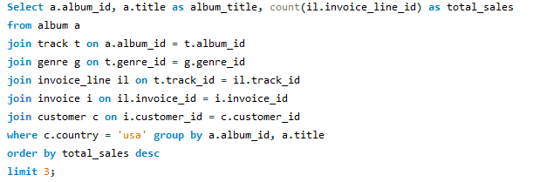
Top Prioritized Albums for Advertising in the USA
Query Explanation:
Determines top-selling genres in each country excluding the USA.
Joins Customer, Invoice, Invoice Line, Track, and Genre tables.
Utilizes ROW_NUMBER() to rank genres by sales volume within each country.
Insights:
Pop and Rock genres dominate sales in most countries.
Classical and Jazz genres stand out in specific regions, suggesting localized preferences.

Slide 16
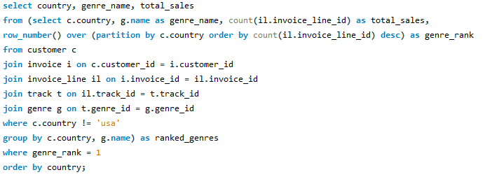
Top-Selling Genres Outside the USA
Query Objective: To identify top-selling albums in the USA by genre sales.
Method: Join Album, Track, Genre, Invoice Line, Invoice, and Customer tables to trace sales to albums; use COUNT and GROUP BY to aggregate and sort sales per album.
Recommendation: Chinook should prioritize albums in Rock and Alternative & Punk genres due to high sales and strong audience engagement.

Slide 17
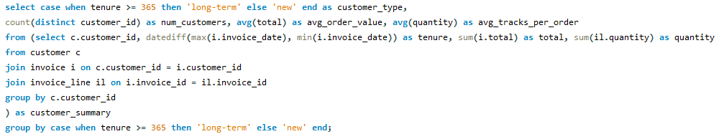
Long-term vs. New Customers' Purchasing Behavior
Query Explanation:
Segments customers based on tenure (long-term vs. new) and analyzes their purchasing habits.
Calculates average order value and tracks per order for each customer segment.
Insights:
Long-term customers spend more per order and purchase more tracks, indicating higher engagement.
New customers show potential for growth with targeted onboarding strategies.

Slide 18
Marketing Strategy
Recommendation: Understanding the preferences of Chinook Music Store’s customer base is crucial for effective marketing. By analyzing sales data, we can identify which genres are most popular among the customers. This insight allows us to tailor improved promotional campaigns to resonate with specific genre preferences.
For example, as Rock genre is the top seller (shown in the visualization below), targeted email campaigns, social media promotions, and in-store displays can feature new releases or special offers in this genre. This personalized approach enhances customer satisfaction and drives higher conversion rates.
Chinook
Music Store

Slide 19

CUSTOMER RETENTION
Recommendation
Recommendation
Visualization
By segmenting customers according to their purchase history and preferences, we can tailor promotional offers and rewards that resonate with each segment, thereby strengthening customer loyalty.
Personalized recommendations based on customers' past purchases and genre preferences can enhance their shopping experience and encourage additional spending.
Total revenue
Total orders

Slide 20
Geographic Expansion
Recommendation: By understanding regional preferences and demographic trends, we can strategically allocate resources for expansion into new markets.
For instance, regions with high average spending per customer or growing populations of music enthusiasts present lucrative opportunities for geographic expansion.
Chinook
Music Store

Slide 21
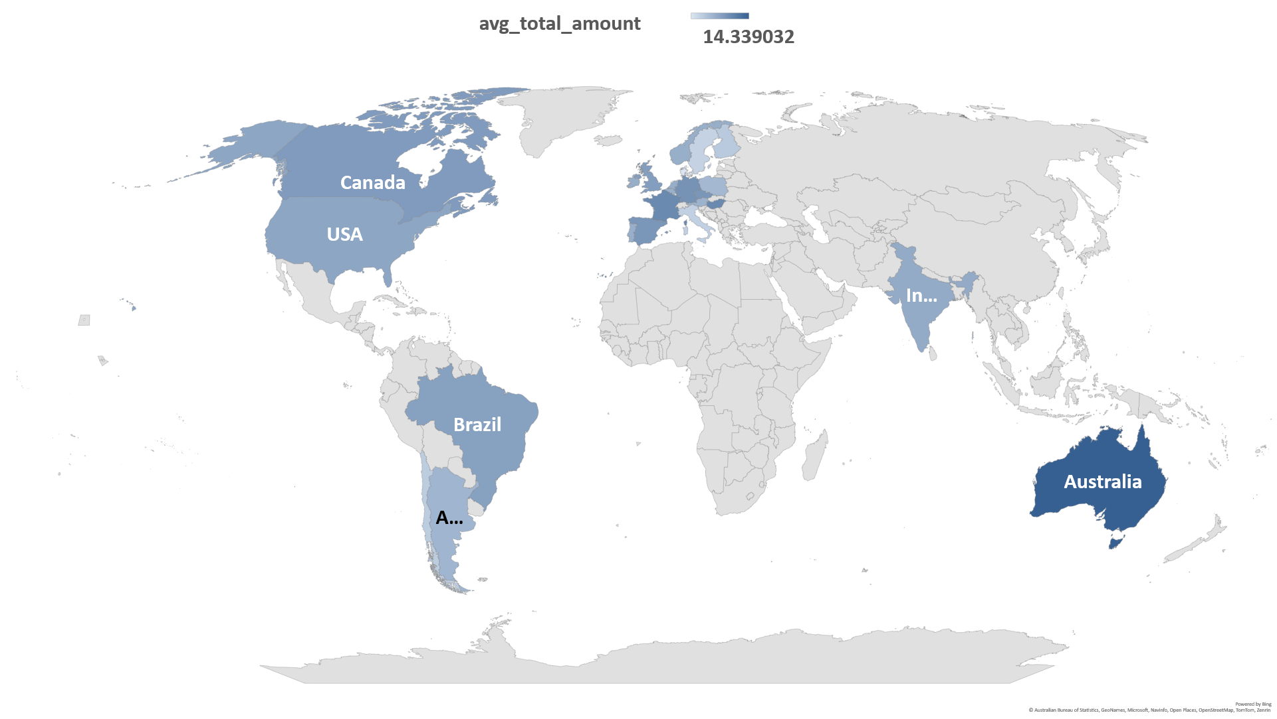

Slide 22

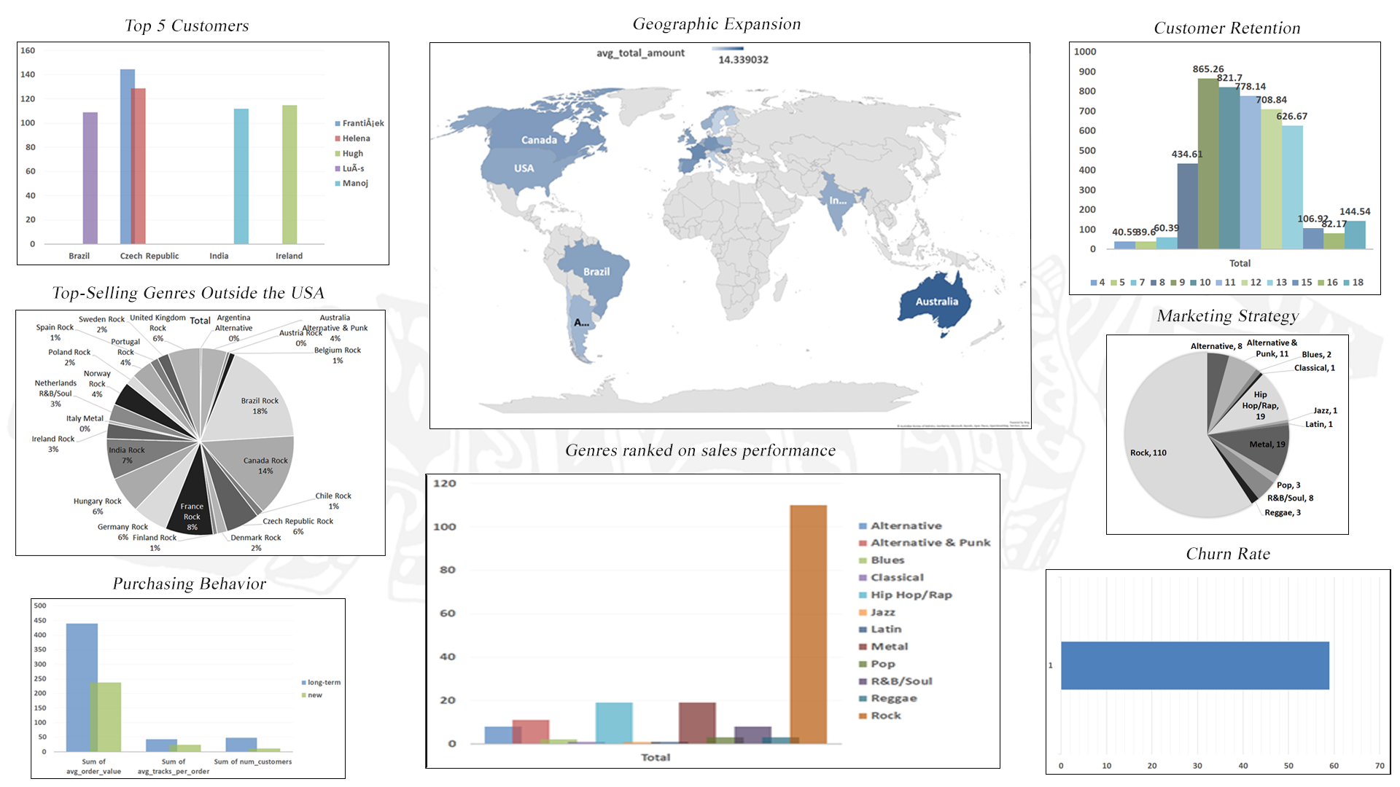
Dashboard
Chinook
Music Store

Slide 23

CONCLUSION
Composing Chinook Music Store’s Future
Leverage dominance of Rock and Pop genres in the USA for targeted marketing efforts.
Tailor marketing strategies based on diverse customer demographics across key regions.
Use insights from purchasing patterns to guide pricing and engagement strategies.
Implement genre-specific marketing to enhance customer engagement and satisfaction.
Promote top-selling tracks and implement customer retention initiatives to drive sustainable growth.
Chinook
Music Store

Slide 24

THANK
YOU
Chinook
Music Store

